Slide 1

Performance Improvement Plan ( PIP)
1

Slide 2
Manager Related Tasks

Slide 3
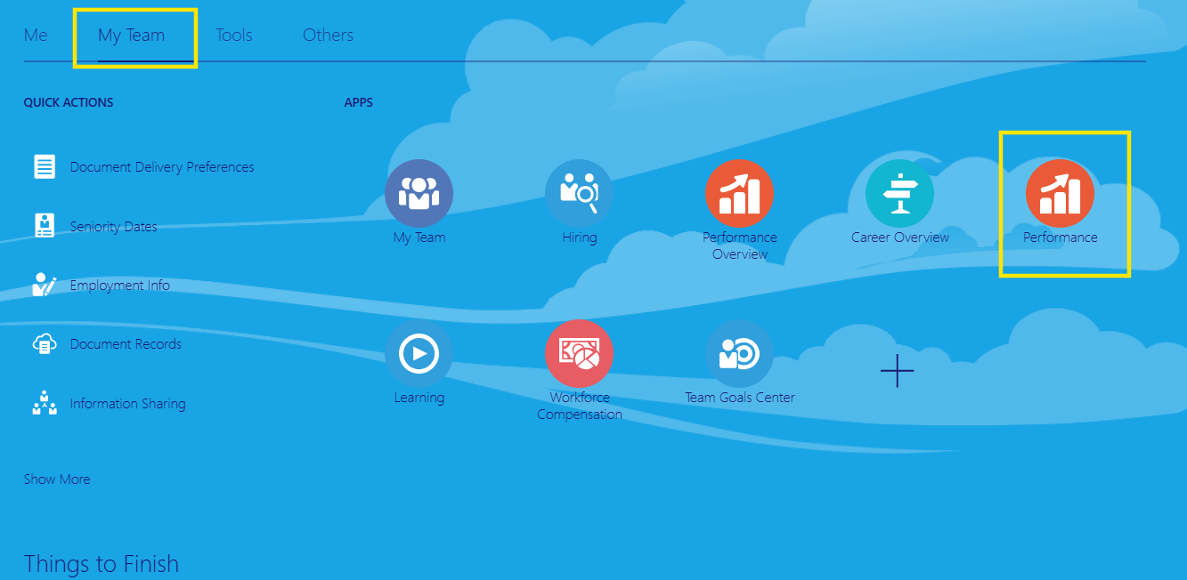
PIP Initiation
Tata Play Universe > My Team > Performance

Slide 4
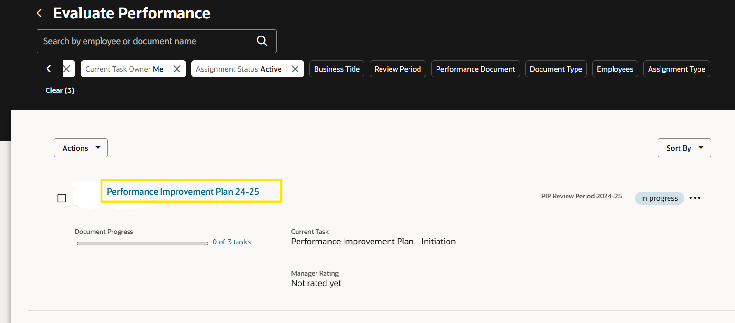
Select the PIP Document

Slide 5
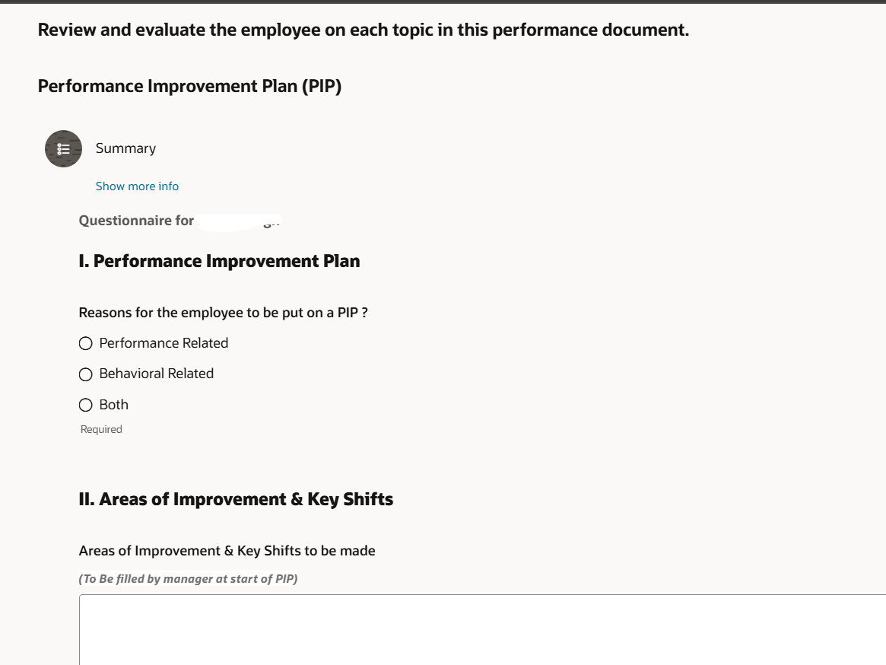
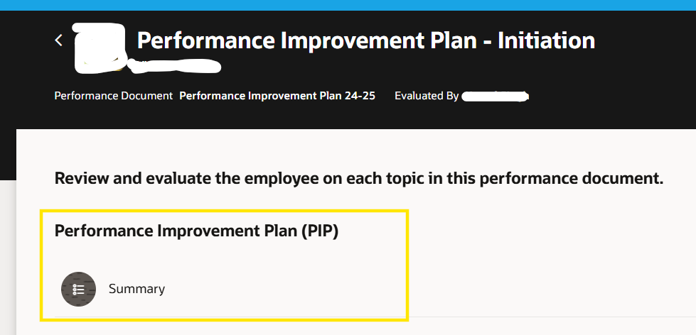
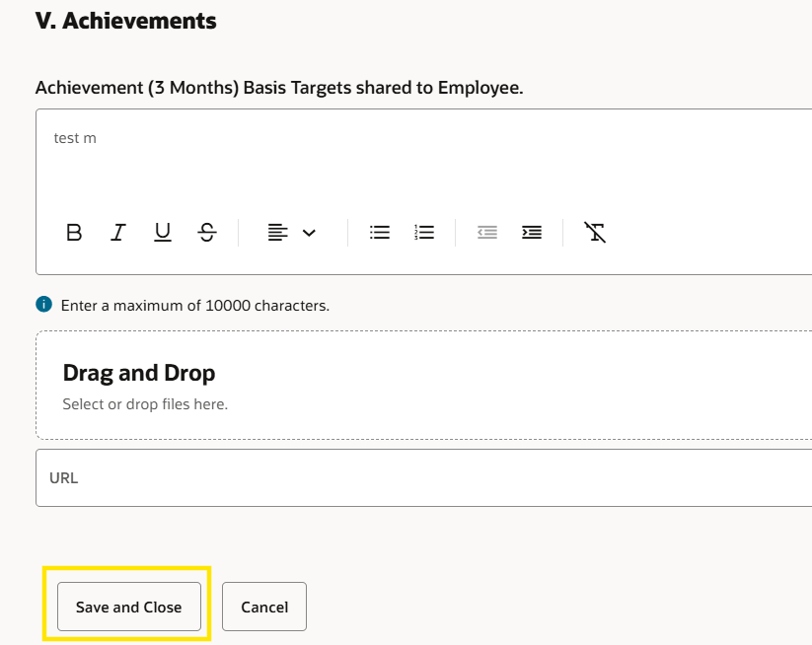
Open the PIP Questionnaire section and provide targets for the employee in the questionnaire.
Click ‘Save and Close’

Slide 6
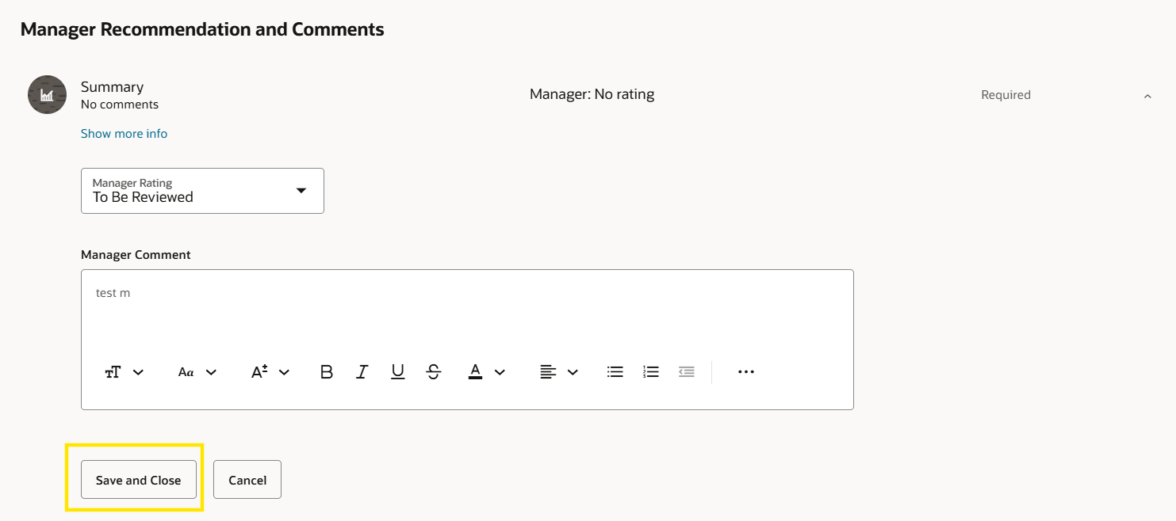
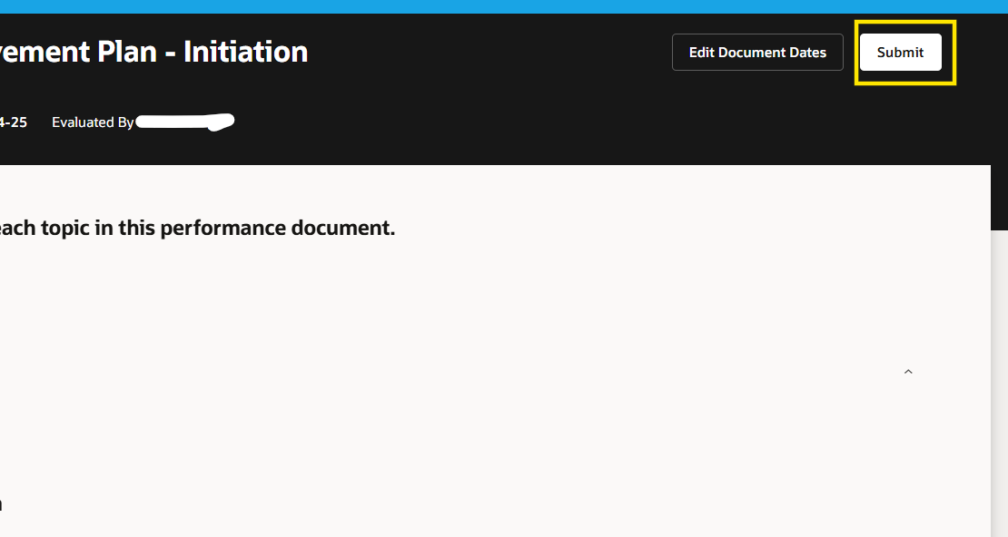
Open the ‘Manager Recommendation and Comments’ and put rating as ‘To be Reviewed’ and click ‘Save and Close’ and the ‘Submit’

Slide 7
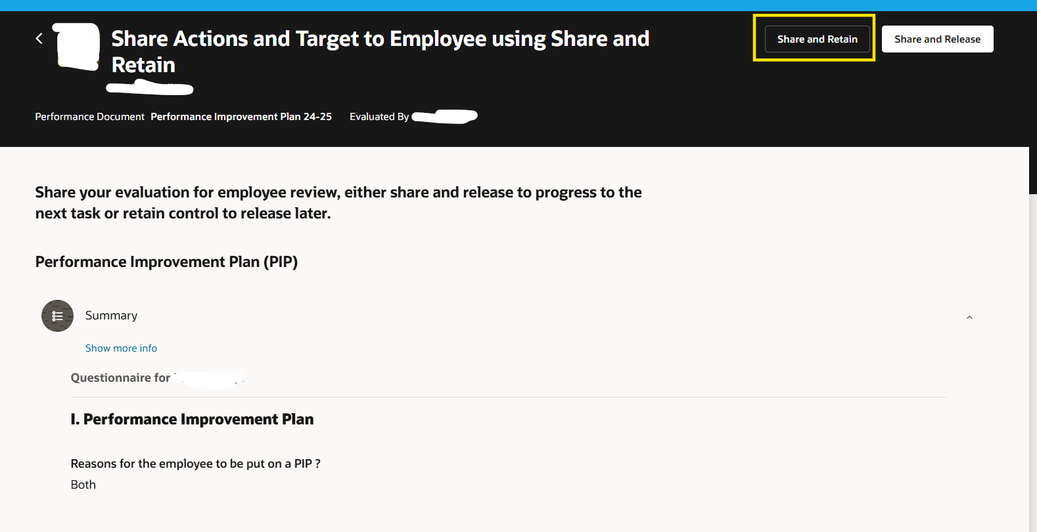
Again, open the PIP document and click ‘Share and Retain’ to share the targets with the employee.

Slide 8

Employee Related Tasks

Slide 9
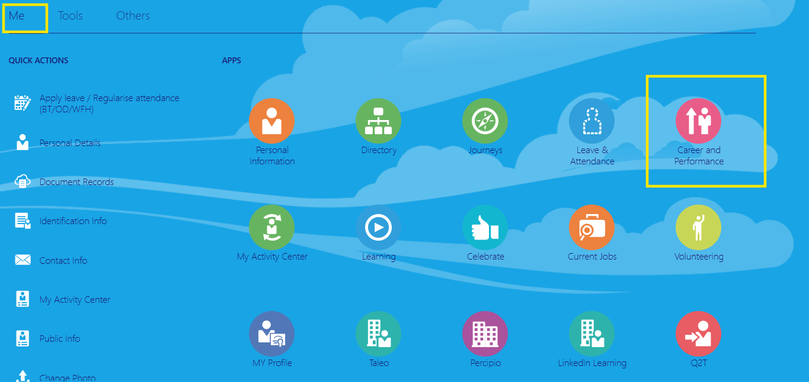
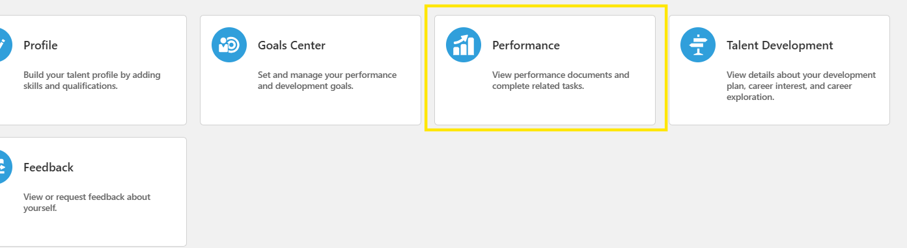
Login into the system
Go to Me > Career and Performance > Performance

Slide 10
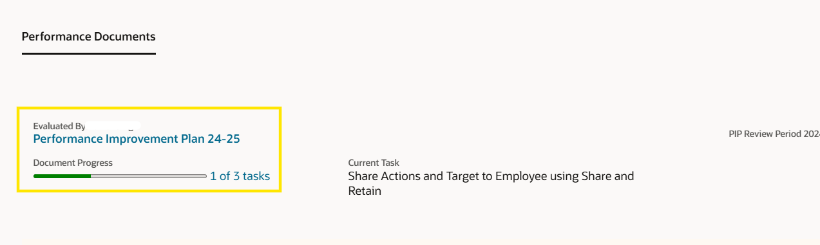
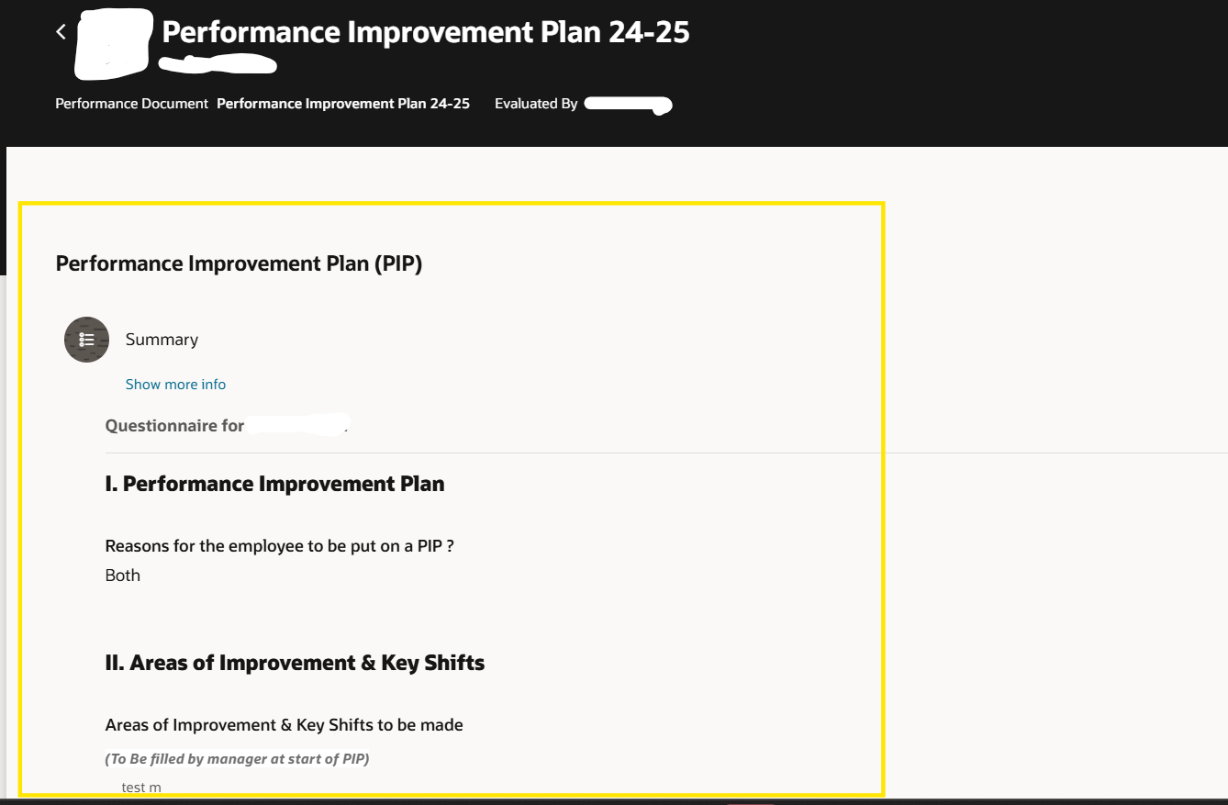
Open the PIP document.
Go to the Performance Improvement Plan section to see the targets set by the manager.

Slide 11
Manager Related Tasks

Slide 12
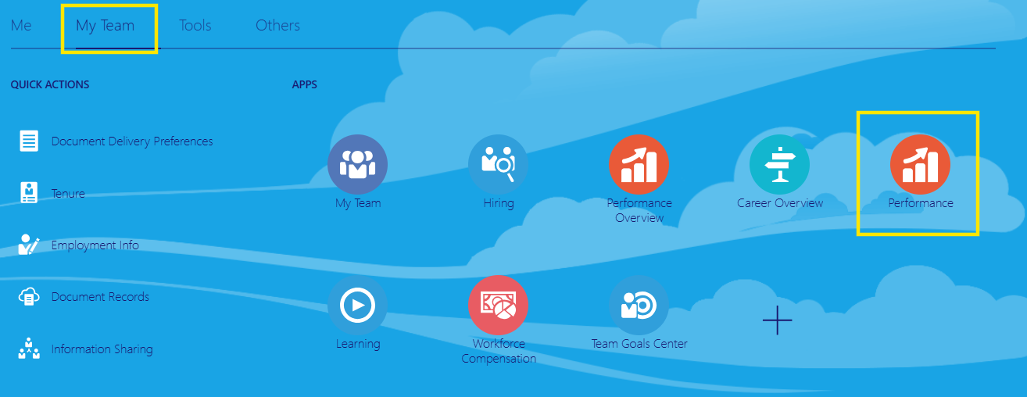
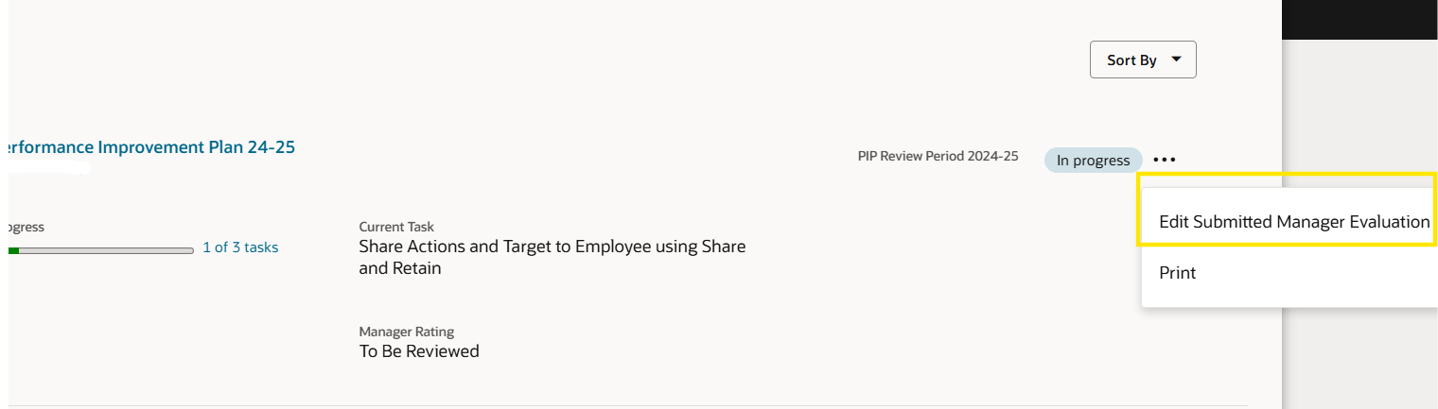
At the end of the PIP manager logs in to the system
My Team > Performance
Click on the three dot right next to the PIP document ‘Edit Submitted Evaluation’

Slide 13
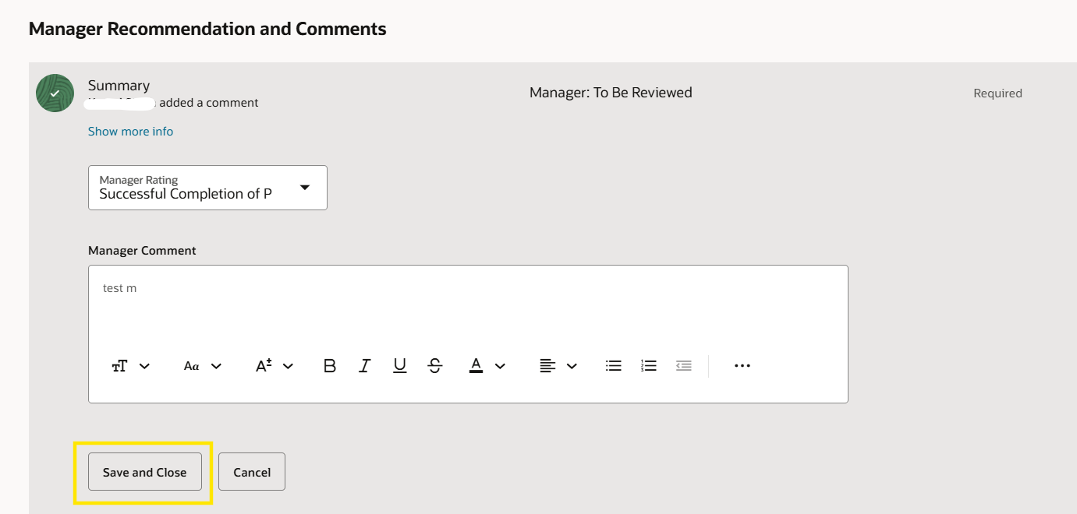
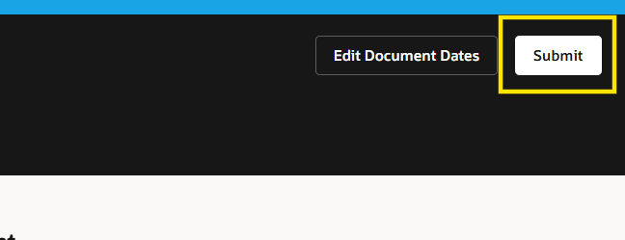
Go the ‘Manager Recommendation and Comments and give final rating as Successful or Unsuccessful completion of PIP and final comments and click ‘Save and Close’
Then click on ‘Submit’

Slide 14
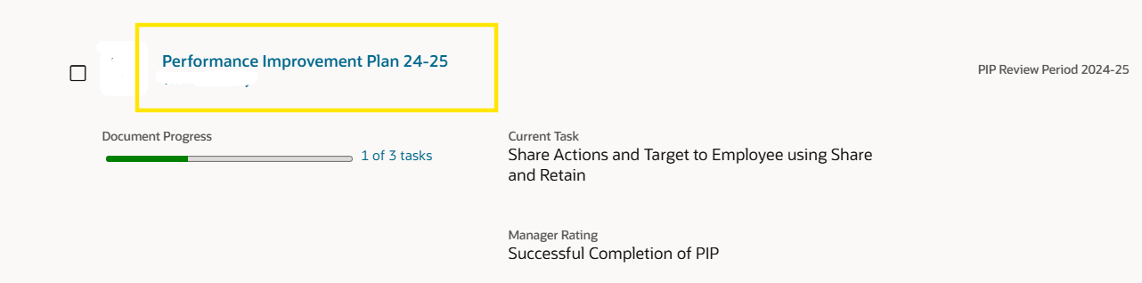
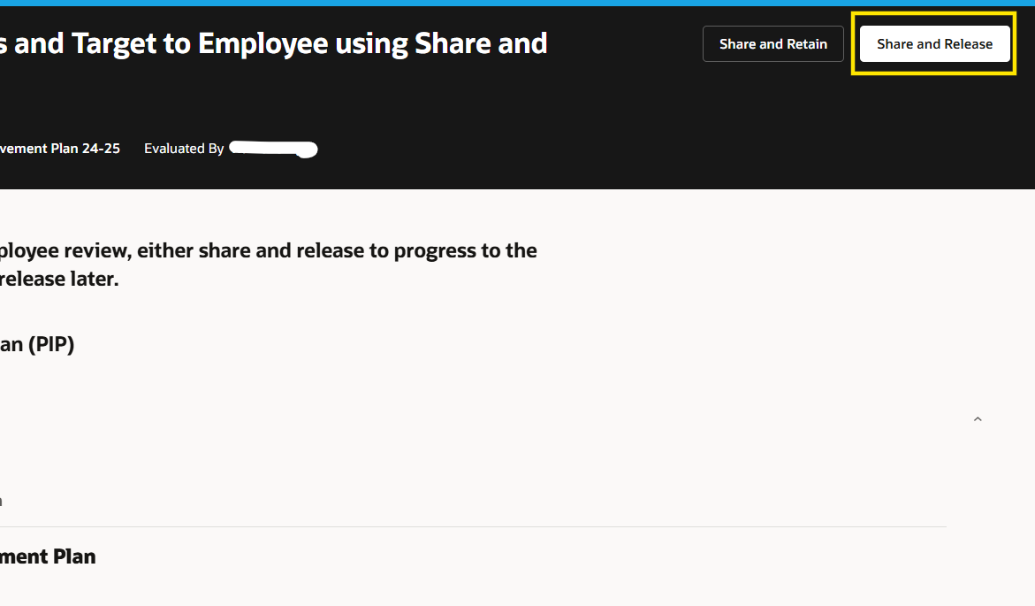
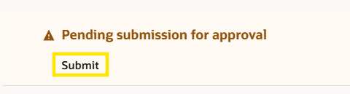
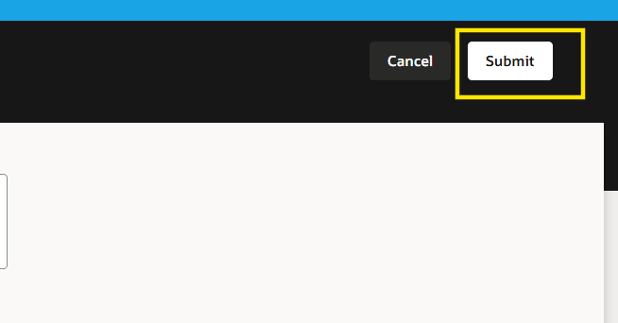
Again, Open the PIP document and click on ‘Share and Release’
Click on ‘Submit’ to send for HR Approvals

Slide 15
HR Approvals

Slide 16
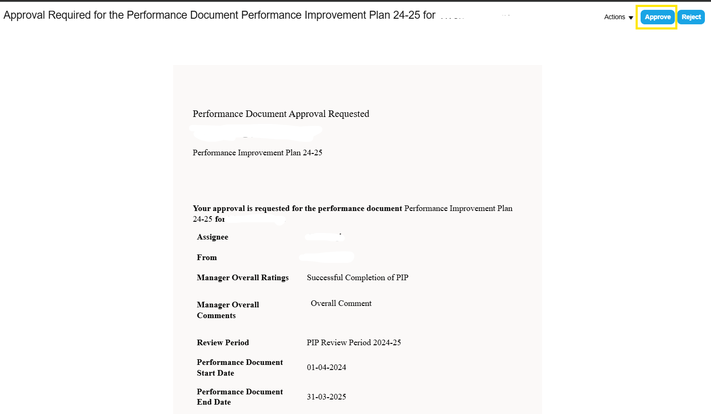
Approval by HR Spoc
There are two ways to approve
1. Approving directly from the notification as shown below
2. By accessing the performance document from the notification (shown in the subsequent slides) and then approving the same

Slide 17
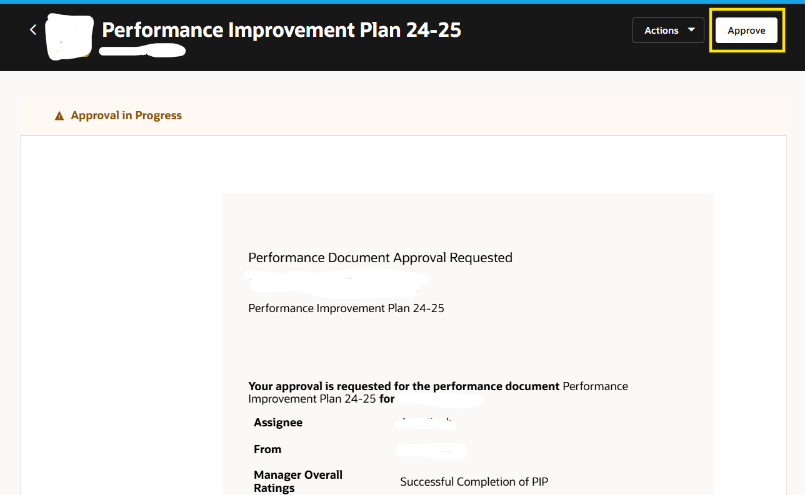
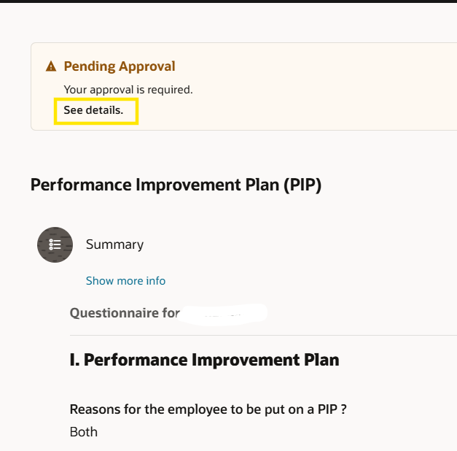
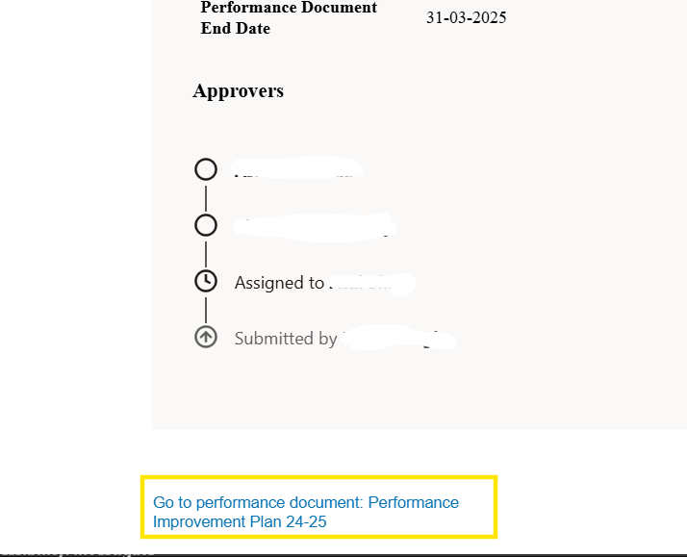
Accessing the performance document from the notification

Slide 18
Thank You

